Slide 1
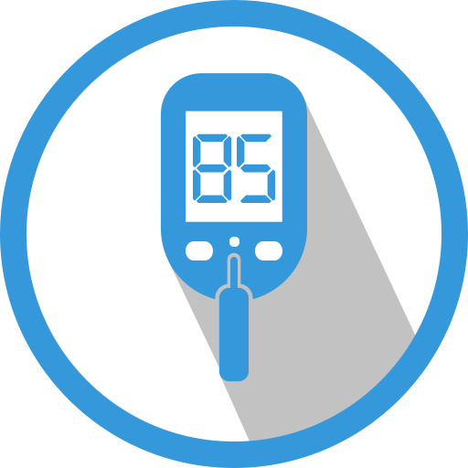
Insulin Pump System

Slide 2
Staff & Collabrators
Supervisors:
PROF DR. Eman Shabaan
DR. Muhammed Marey
TA. Youmna Mohsen
Team Members:
Rwan Wael Ali
Sandra Yasser Boshra
Abeer Fathy Mousa
Omar Taha Muhammed
Abdelrahman Baher

Slide 3
Agenda
Introduction
Problem definition
Objective
System architecture
System analysis
System design and implementation
Tools
Demo
Conclusion and future work
Attempts
Time plan
Reference

Slide 4

Introduction
Diabetes Mellitus (DM), which is usually referred to Diabetes, is a worldwide chronic metabolic disorder that involves abnormal blood glucose levels, which can cause diverse health disorders that affect their heart, weakness, and dizziness, while too much can lead to vision and nerve problems, kidney disease, and strokes. Either situation can eventually lead to death Due to these conditions.

Slide 5
Introduction
Types of diabetes:
Type 1 diabetes can develop at any age, but occurs most frequently in children and adolescents. When you have type 1 diabetes, your body produces very little or no insulin, which means that you need daily insulin injections to maintain blood glucose levels under control.
Type 2 diabetes When you have type 2 diabetes, your body does not make good use of the insulin that it produces. The cornerstone of type 2 diabetes treatment is healthy lifestyle, including increased physical activity and diet.
Gestational diabetes (GDM) is a type of diabetes that consists of high blood glucose during pregnancy and is associated with complications to both mother and child. GDM usually disappears after pregnancy but women affected and their children are at increased risk of developing type 2 diabetes later in life.

Slide 6
Problem Definition
With the high rates of diabetes and increasing the rates of health disorders that affect their heart, headaches, weakness, and dizziness, while too much can lead to vision problems and kidney disease. Either situation can eventually lead to death.
diabetes patients have traditionally checked blood glucose levels through self-monitoring of blood glucose techniques, like pricking their fingers multiple times per day. Such techniques involve a number of drawbacks

Slide 7

Objectives
User can analyze data to monitor the glucose in blood by using the application.
User takes suitable dose of insulin by the insulin pump
Warning user when his glucose rate exceeds the normal range by the application
The doctor monitors the blood glucose level of his patients weekly and sends them reports if possible.
System can help type one diabetes only.

Slide 8
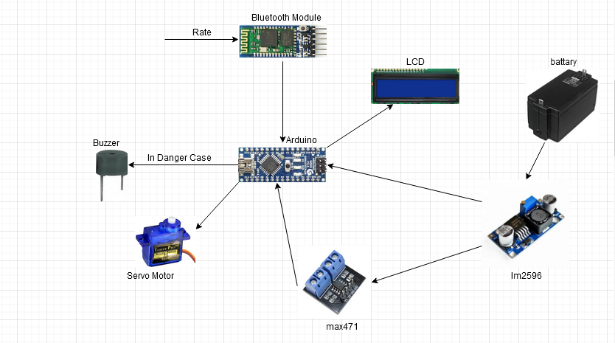
System Architecture
Hardware Architecture

Slide 9
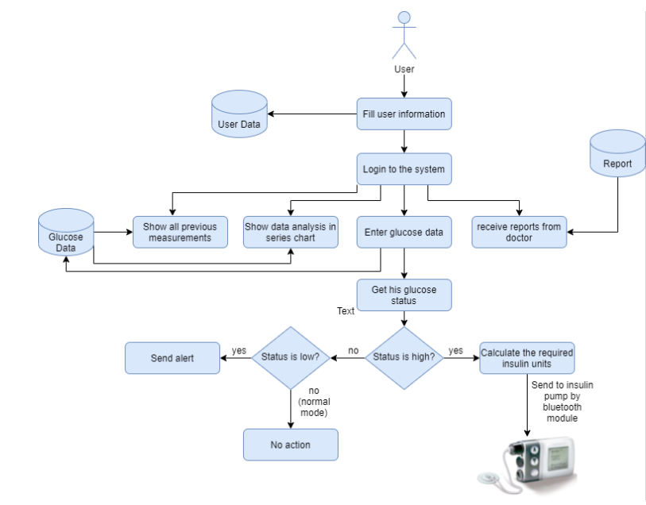
System Architecture
Software Architecture

Slide 10
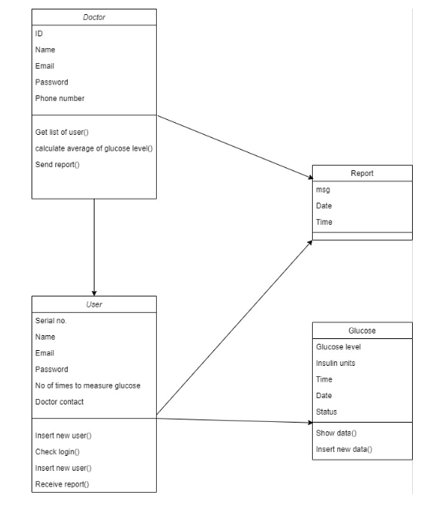
System Analysis
Class diagram

Slide 11
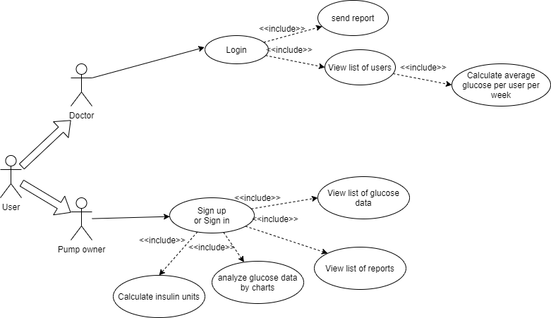
System Analysis
Use Case

Slide 12
System Analysis
Data Base
Firebase database is a set of collections
Each collection has a set of documents
Each document contains a set of sub collections and fields, etc
User and Doctor are collections
Glucose and Reports are sub collections in every user

Slide 13
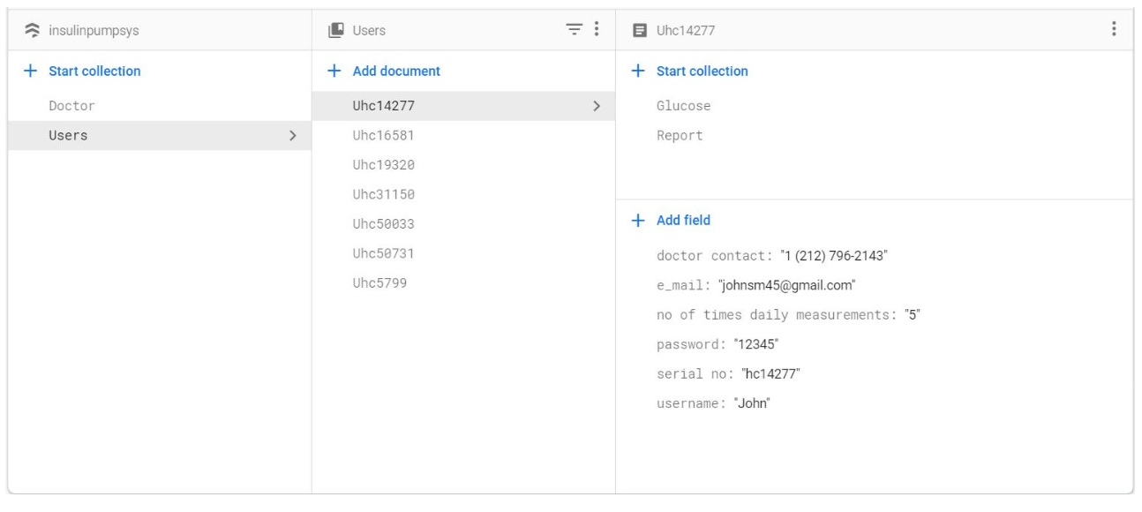
System Analysis
Data Base

Slide 14
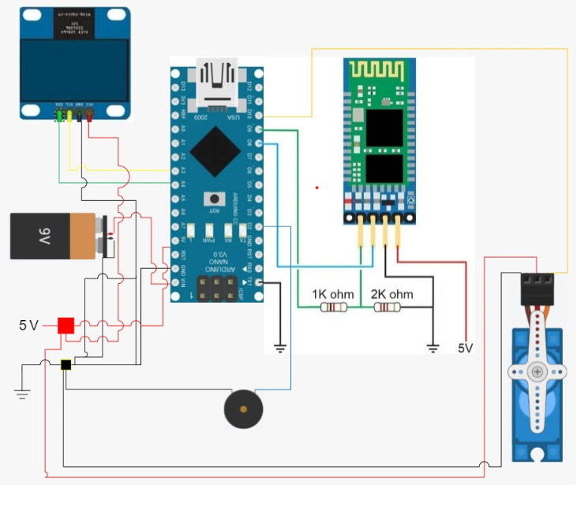
System Design & Implementation
Pump Circuit

Slide 15
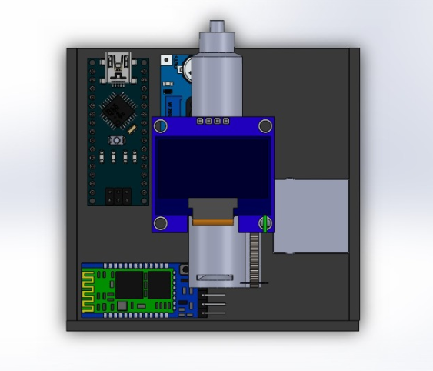
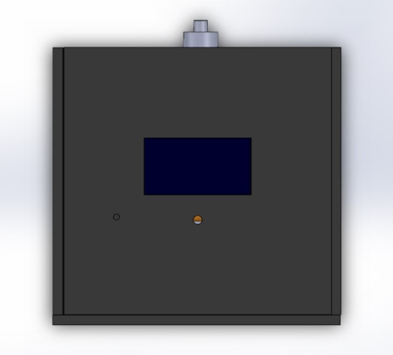
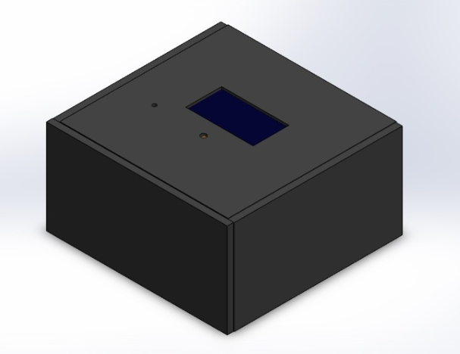
System Design & Implementation
CAD Modeling

Slide 16
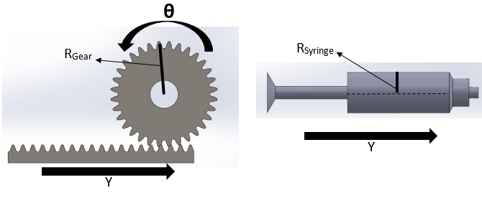
System Design & Implementation
Movement
Y = R_{Gear} x θ
Area of cylinder = π x R_{sy}
Volume = Area of cylinder x Y
When the servo rotates the gear of radius R_{Gear} with angle θ, the gear will move distance Y on the rack.
As the syringe is a cylinder then its area is π x R_{Syringe}² and then the amount of the insulin dosage is equal to syringe area x.
So, to get the amount of the dosage required we will calculate the angle of servo rotation as the other constraints are constants.

Slide 17
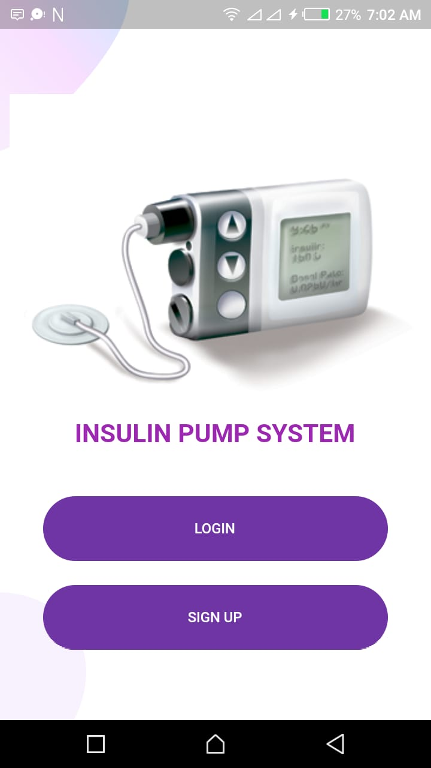
System Design & Implementation
Application : flutter application is connected to firebase database to make it easier for the user to monitor the level of sugar and units that have been taken in each measurement and warn him when his blood sugar is high or low.

Slide 18
Tools
Software Tools
Android Studio
Firebase
Arduino IDE
Solidworks
Hardware Tools
Arduino Nano
Servo motor
LCD 16*2
Buzzer
Bluetooth Module
Max471”Current & Voltage sensor”
Battery & Im2596

Slide 19

Demo

Slide 21
Conclusion
In Conclusion our project aims to make a complete system for all the diabetes to make them deal with their problem in easier way by:
calculating the appropriate dose for the patients by the insulin pump and the application can monitor their glucose in blood.
helping the diabetes to take their suitable dose of the insulin in the correct time.

Slide 22
Future Work
Implementation of a device that measures glucose level automatically and continuously in a non-invasive manner and with high accuracy
Using glucose sensor “high accuracy but limited lifetime”
Using near infra red sensors

Slide 23
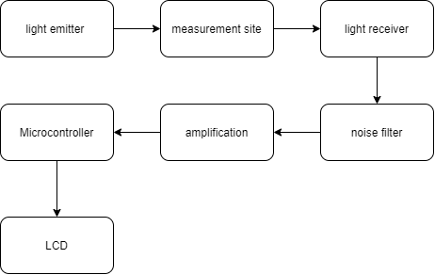
Attempts
Near infra red sensors
When a light ray passes through biological tissues, it is both absorbed and scattered by the tissues
Light receiver as LDR , photo diode

Slide 24
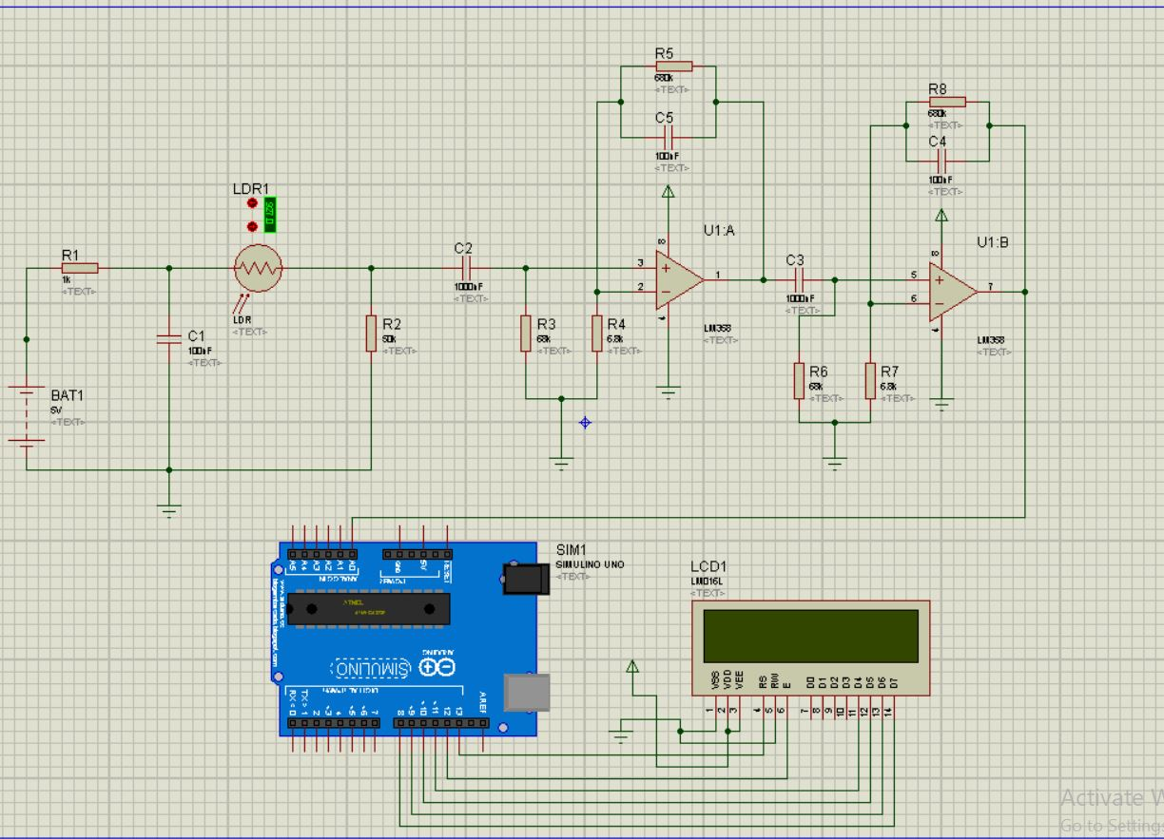
Attempts
Circuit

Slide 25
References
https://www.medtronicdiabetes.com/products/minimed-770g-insulin-pump-system
https://www.freestyle.abbott/us-en/products/freestyle-14-day.html
https://www.dexcom.com/home
https://console.firebase.google.com/
https://www.ijltet.org/journal/151486536919.%2065.pdf

Slide 26


